Slide 1


COMP1030 Lecture #3
Introduction to java

Slide 2
Housekeeping
Our goal - 100% pass rate in this course.
Review the lecture slides ahead of time.
Review the lecture slides after class with a study group.
Repeat the lab at home 1-2 times.
Take notes during class.
Weekly optional tutorials will begin next
week (Jan 27)- watch for blackboard announcement
The four secrets of success

Slide 3
Review
Comments
Semicolon, blocks, whitespace
Identifiers
Java keywords
Types (boolean, textual, integral, floating)
Arithmetic operators
Equality and relational operators
Programming conventions
Import Statements

Slide 4
Instance variables, setters, getters
An instance variable is specific to the object that is created (instantiated) from a class.
Instance variables maintain data for each object (instance) of the class.
Instance variables are not shared among instances.

Slide 5
Instance variables, setters, getters
public class Account
{
private String name;
private int accountNumber;
}

Slide 6
Instance variables, setters, getters
private variables or methods are accessible only to methods of the class in which they are declared.
public variables/methods are available outside the class
Instance variables are typically listed first in the classes body, and are typically private to enforce security through data hiding (encapsulation).

Slide 7
Instance variables, setters, getters
Every instance variable has a default initial value if you do not specify an initial value.
Each object (instance of a class) has its own copy of the class’s instance variables.
A class normally contains methods (setters, getters) to manipulate or access its instance variables

Slide 8
Method signature
Parameter
public void setName(String usersName)
{
name = usersName;
}
Variables declared in the method signature are called parameters, and are local variables which can only be used in that method. When a method terminates the values of its local variables are lost.

Slide 9
Method signature
public String getName()
{
return name;
}
Methods can return a value to the caller by using the keyword ‘return’.
If a method does not return anything its return type is ‘void’.

Slide 10
Instantiating a new object
The keyword “new” creates a new object of the specified class.
Account savingsAccount = new Account();
savingsAccount
Behaviour
Reference to the object
State
Object of type Account

Slide 11
Constructors
A constructor is a block of code (method) that is called when a new object is created using the new keyword.
A constructor does not have a return type.
The name of the constructor must have the same name as the class.
A constructor can take a comma separated parameter list to provide initial values for instance variables.

Slide 12
Constructors
public Customer (String first, String last)
{
firstName = first;
lastName = last;
}
Customer c = new Customer(“Bill”, “Black”);

Slide 13
Constructors
A class can have multiple constructors (constructor overloading).
Each constructor must have a different signature. (# of parameters, type of parameters, or order of parameters)
Constructors are not inherited.
If you do not write a constructor the java compiler will create a default constructor with no parameters.

Slide 14
Constructors
If you declare any constructors, java will NOT create the default constructor.
Customer c = new Customer();

Slide 15
Understanding the main method
public static void main (String [] args)
The main method is the entry point to your program as it is called automatically by the JVM. Most other methods must be explicitly called.

Slide 16
Understanding the main method
public static void main (String [] args)
static – method can be called without having to instantiate an object.
public – can be called by any object.
void – no return type
String [] args – accepts a single argument of an array ([]) of Strings.

Slide 17
Understanding the main method
public static void main (String [] args)
The array ([]) of Strings is a mechanism through which the runtime system passes information (command line arguments) to your application.
This allows the user to use command line arguments to affect the operation of the application without re-compiling it.

Slide 18
Review of the String class
A String is an Object.
A String is a sequence of characters.
A String is immutable – once created it cannot be changed.

Slide 19
Understanding the String class
Strings can be created in two ways:
String s1 = “Hello”;
String s2 = “Hello”;
Note no use of the “new” keyword. (implicit instantiation)
In this case java creates only ONE String object with two references pointing to it.

Slide 20
Understanding the String class
String s1 = new String(“Hello”);
String s2 = new String(“Hello”);
In this case java creates two objects.

Slide 21
Argument Promoting and Casting
The Math.sqrt() method expects a double argument.
However Math.sqrt(4); is valid because java will automatically promote (convert) the int 4 to a double because no data will be lost in this promotion.

Slide 22
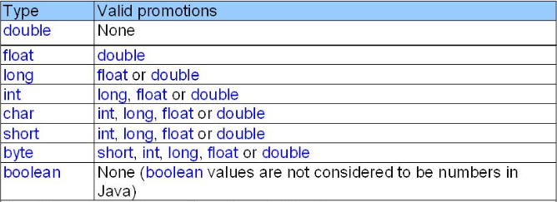
Argument Promoting and Casting
Promotions allowed for primitive types

Slide 23
Argument Promoting and Casting
Converting a double to an int will truncate the fractional portion of the double value, therefore part of the value is lost.
If one attempts to use a type that requires a demotion (converting to a lower type) the compiler will error out.
To force conversion (essentially saying to the compiler, I know this conversion might cause loss of information, but in this situation it is ok) we can use the cast operator.

Slide 24
Argument Promoting and Casting
Example
A method called calculateResult requires an argument of type int.
To pass a double we would need to cast the double to an int: (this is known as type casting)
ref.calculateResult((int)32.64);

Slide 25
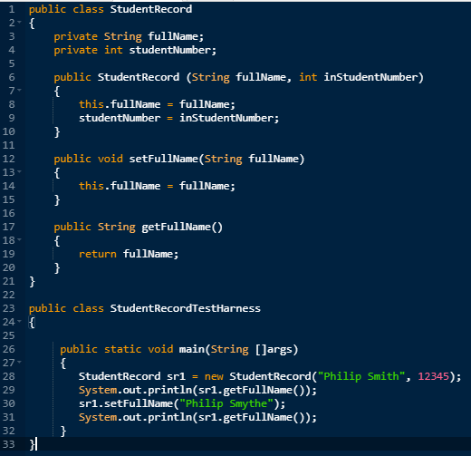

Code Example
Output

Slide 26
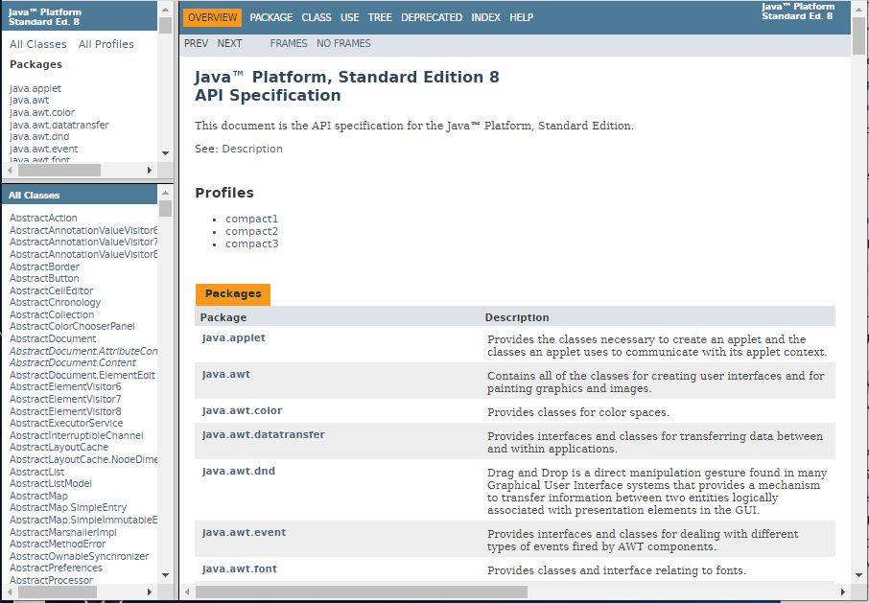
Java Documentation
https://docs.oracle.com/javase/8/docs/api/

